Slide 1
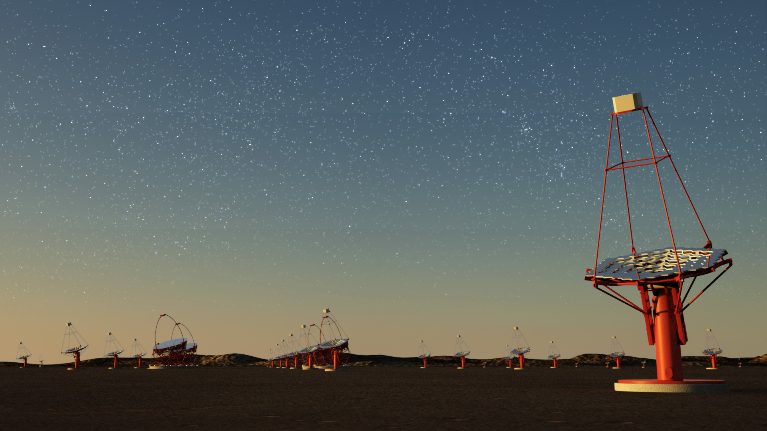

Postdoctoral Research Fellowship Positions
The Centre for Astro-Particle Physics (CAPP) at the University of Johannesburg, South Africa invites applications for two postdoctoral research fellowships in Astroparticle Physics or High-energy Astrophysics.
CAPP members are involved in
Fermi Large Area Space Telescope
Cherenkov Telescope Array
KM3NeT Neutrino Observatory
Interested candidates must send
Curriculum Vitae
List of publications
Proposed research plan
Names and email addresses of 2 referees
or any enquiry directly to Ms. Anna Samara Larmuth (capp@uj.ac.za).
The positions will remain open until filled.
www.uj.ac.za/capp

